Slide 1
Java GUI Libraries
Swing Programming

Slide 2
Swing Components
Swing is a collection of libraries that contains primitive widgets or controls used for designing Graphical User Interfaces (GUIs).
Commonly used classes in javax.swing package:
  JButton, JTextBox, JTextArea, JPanel, JFrame, JMenu, JSlider, JLabel, JIcon, …
  There are many, many such classes to do anything imaginable with GUIs
  Here we only study the basic architecture and do simple examples

Slide 3
Swing components, cont.
Each component is a Java class with a fairly extensive inheritency hierarchy:
Object
Component
Container
JComponent
Window
JPanel
Frame
JFrame

Slide 4
Using Swing Components
Very simple, just create object from appropriate class – examples:
  JButton but = new JButton();
  JTextField text = new JTextField();
  JTextArea text = new JTextArea();
  JLabel lab = new JLabel();
Many more classes. Don’t need to know every one to get started.
See ch. 9 Hortsmann

Slide 5
Adding components
Once a component is created, it can be added to a container by calling the container’s add method:
This is required
Container cp = getContentPane();
cp.add(new JButton(“cancel”));
cp.add(new JButton(“go”));
How these are laid out is determined by the layout manager.

Slide 6
Laying out components
Not so difficult but takes a little practice
Do not use absolute positioning – not very portable, does not resize well, etc.

Slide 7
Laying out components
Use layout managers – basically tells form how to align components when they’re added.
Each Container has a layout manager associated with it.
A JPanel is a Container – to have different layout managers associated with different parts of a form, tile with JPanels and set the desired layout manager for each JPanel, then add components directly to panels.

Slide 8
Layout Managers
Java comes with 7 or 8. Most common and easiest to use are
  FlowLayout
  BorderLayout
  GridLayout
Using just these three it is possible to attain fairly precise layout for most simple applications.

Slide 9
Setting layout managers
Very easy to associate a layout manager with a component. Simply call the setLayout method on the Container:
JPanel p1 = new JPanel();
p1.setLayout(new FlowLayout(FlowLayout.LEFT));
JPanel p2 = new JPanel();
p2.setLayout(new BorderLayout());
As Components are added to the container, the layout
manager determines their size and positioning.

Slide 10
Event handling

Slide 11
What are events?
All components can listen for one or more events.
Typical examples are:
  Mouse movements
  Mouse clicks
  Hitting any key
  Hitting return key
  etc.
Telling the GUI what to do when a particular event occurs is the role of the event handler.

Slide 12
ActionEvent
In Java, most components have a special event called an ActionEvent.
This is loosely speaking the most common or canonical event for that component.
A good example is a click for a button.
To have any component listen for ActionEvents, you must register the component with an ActionListener. e.g.
  button.addActionListener(new MyAL());

Slide 13
Delegation, cont.
This is referred to as the Delegation Model.
When you register an ActionListener with a component, you must pass it the class which will handle the event – that is, do the work when the event is triggered.
For an ActionEvent, this class must implement the ActionListener interface.
This is simple a way of guaranteeing that the actionPerformed method is defined.

Slide 14
actionPerformed
The actionPerformed method has the following signature:
  void actionPerformed(ActionEvent)
The object of type ActionEvent passed to the event handler is used to query information about the event.
Some common methods are:
  getSource()
    object reference to component generating event
  getActionCommand()
    some text associated with event (text on button, etc).

Slide 15
actionPerformed, cont.
These methods are particularly useful when using one eventhandler for multiple components.

Slide 16
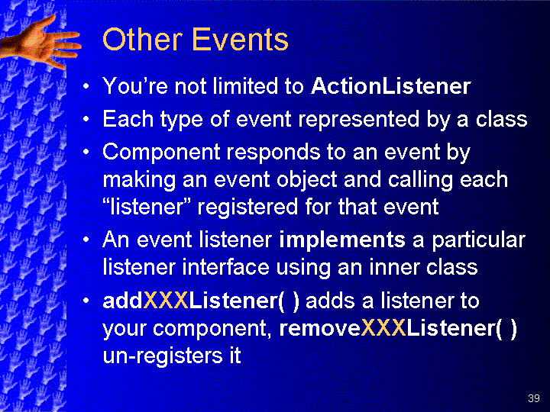

Slide 17
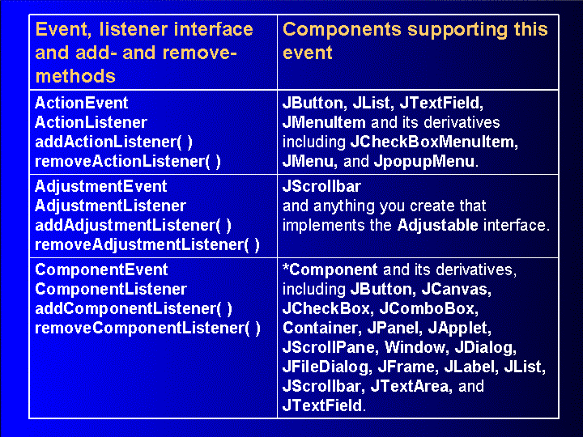

Slide 18
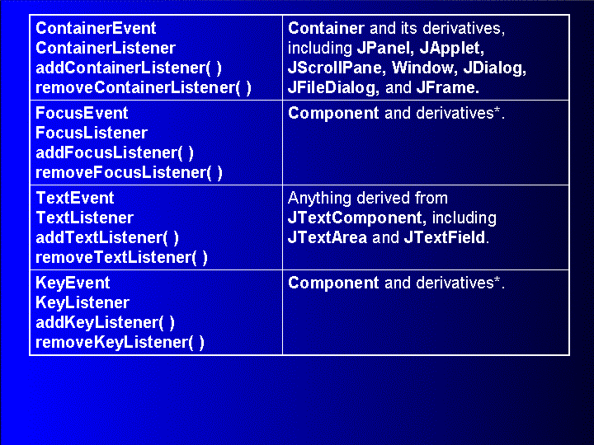

Slide 19
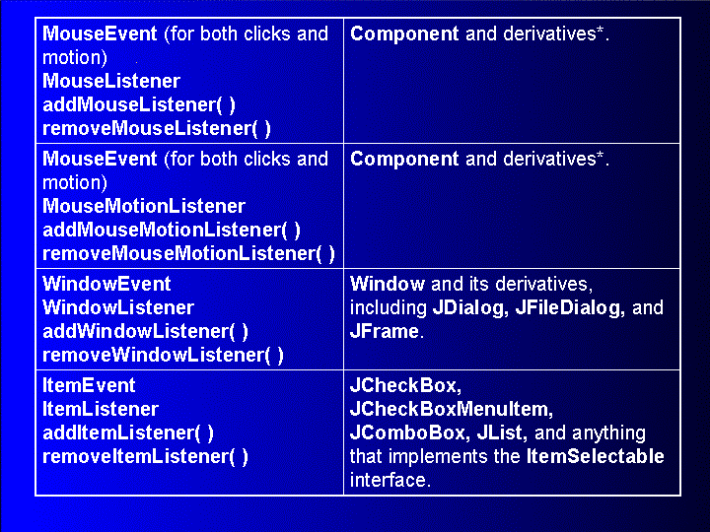

Slide 20
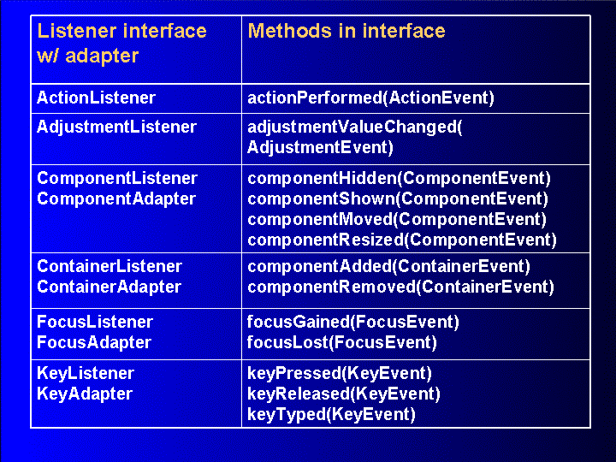

Slide 21
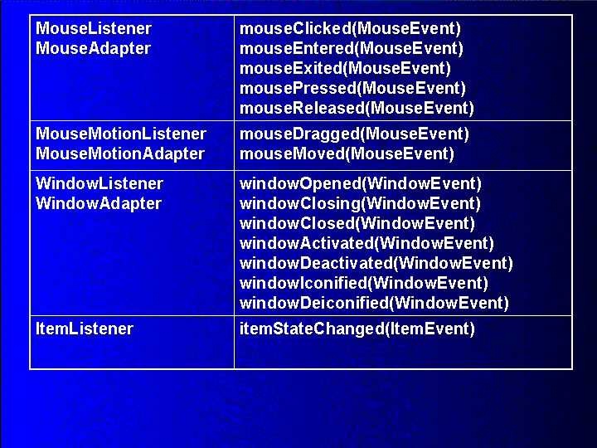

Slide 22
Simplest GUI
import javax.swing.JFrame;
class SimpleGUI extends JFrame{
SimpleGUI(){
setSize(400,400); //set frames size in pixels
setDefaultCloseOperation(EXIT_ON_CLOSE);
show();
}
public static void main(String[] args){
SimpleGUI gui = new SimpleGUI();
System.out.println(“main thread coninues”);
}
}

Slide 23
Another Simple GUI
import javax.swing.*;
class SimpleGUI extends JFrame{
SimpleGUI(){
setSize(400,400); //set frames size in pixels
setDefaultCloseOperation(EXIT_ON_CLOSE);
JButton but1 = new JButton(“Click me”);
Container cp = getContentPane();//must do this
cp.add(but1);
show();
}
public static void main(String[] args){
SimpleGUI gui = new SimpleGUI();
System.out.println(“main thread coninues”);
}}

Slide 24
Add Layout Manager
import javax.swing.*; import java.awt.*;
class SimpleGUI extends JFrame{
SimpleGUI(){
setSize(400,400); //set frames size in pixels
setDefaultCloseOperation(EXIT_ON_CLOSE);
JButton but1 = new JButton(“Click me”);
Container cp = getContentPane();//must do this
cp.setLayout(new FlowLayout(FlowLayout.CENTER);
cp.add(but1);
show();
}
public static void main(String[] args){
SimpleGUI gui = new SimpleGUI();
System.out.println(“main thread coninues”);
}}

Slide 25
Add call to event handler
import javax.swing.*; import java.awt.*;
class SimpleGUI extends JFrame{
SimpleGUI(){
setSize(400,400); //set frames size in pixels
setDefaultCloseOperation(EXIT_ON_CLOSE);
JButton but1 = new JButton(“Click me”);
Container cp = getContentPane();//must do this
cp.setLayout(new FlowLayout(FlowLayout.CENTER);
but1.addActionListener(new MyActionListener());
cp.add(but1);
show();
}
public static void main(String[] args){
SimpleGUI gui = new SimpleGUI();
System.out.println(“main thread coninues”);
}}

Slide 26
Event Handler Code
class MyActionListener implements ActionListener{
public void actionPerformed(ActionEvent ae){
JOptionPane.showMessageDialog(“I got clicked”, null);
}
}

Slide 27
Add second button/event
class SimpleGUI extends JFrame{
SimpleGUI(){
/* .... */
JButton but1 = new JButton(“Click me”);
JButton but2 = new JButton(“exit”);
MyActionListener al = new MyActionListener();
but1.addActionListener(al);
but2.addActionListener(al);
cp.add(but1);
cp.add(but2);
show();
}
}

Slide 28
How to distinguish events –Less good way
class MyActionListener implents ActionListener{
public void actionPerformed(ActionEvent ae){
if (ae.getActionCommand().equals(“Exit”){
System.exit(1);
}
else if (ae.getActionCommand().equals(“Click me”){
JOptionPane.showMessageDialog(null, “I’m clicked”);
}
}

Slide 29
Good way
class MyActionListener implents ActionListener{
public void actionPerformed(ActionEvent ae){
if (ae.getSource() == but2){
System.exit(1);
}
else if (ae.getSource() == but1){
JOptionPane.showMessageDialog(null, “I’m clicked”);
}
}
Question: How are but1, but2 brought into scope to do this?
Question: Why is this better?

Slide 30
Putting it all together
See LoginForm.java example in class notes

